Slide 1
Batch 5 : Team 5
Banking Website

Slide 2
Project overview
This is a banking application made using React Front-end and Java-Spring boot backend and MySQL database. Application allows the customer to register themselves, create accounts, withdraw/deposit money into accounts , transact money and view their current account’s balance.
Apart from this , the app offers certain admin specific functionalities for bank employees who can register themselves, search for details of a particular account / customer , activate/suspend account of a particular customer, view the entire transaction history of a particular account or customer

Slide 3
Features
Customer Dashboard
Register customer
Authentication with customer id and password
Create account
Withdraw / Deposit money
Fund transfer between accounts
View transaction history
Check bank balance
Add and update personal details
Log out

Slide 4
Admin Dashboard
Register admin
Authentication with admin id and password
Create account for a specific user
View all account details of a specific user
View all transaction history of a given customer or account
View the customer personal information
Check bank balance of all customer’s accounts
Activate or suspend a particular account
Log out

Slide 5
Tech Stack
Frontend
Backend
Spring Boot
My SQL Database
Spring Test
React js
Axios
Bootstrap
Cdbreact
Font-awesome
React sweet alerts
React router dom
React hook form
React select

Slide 6
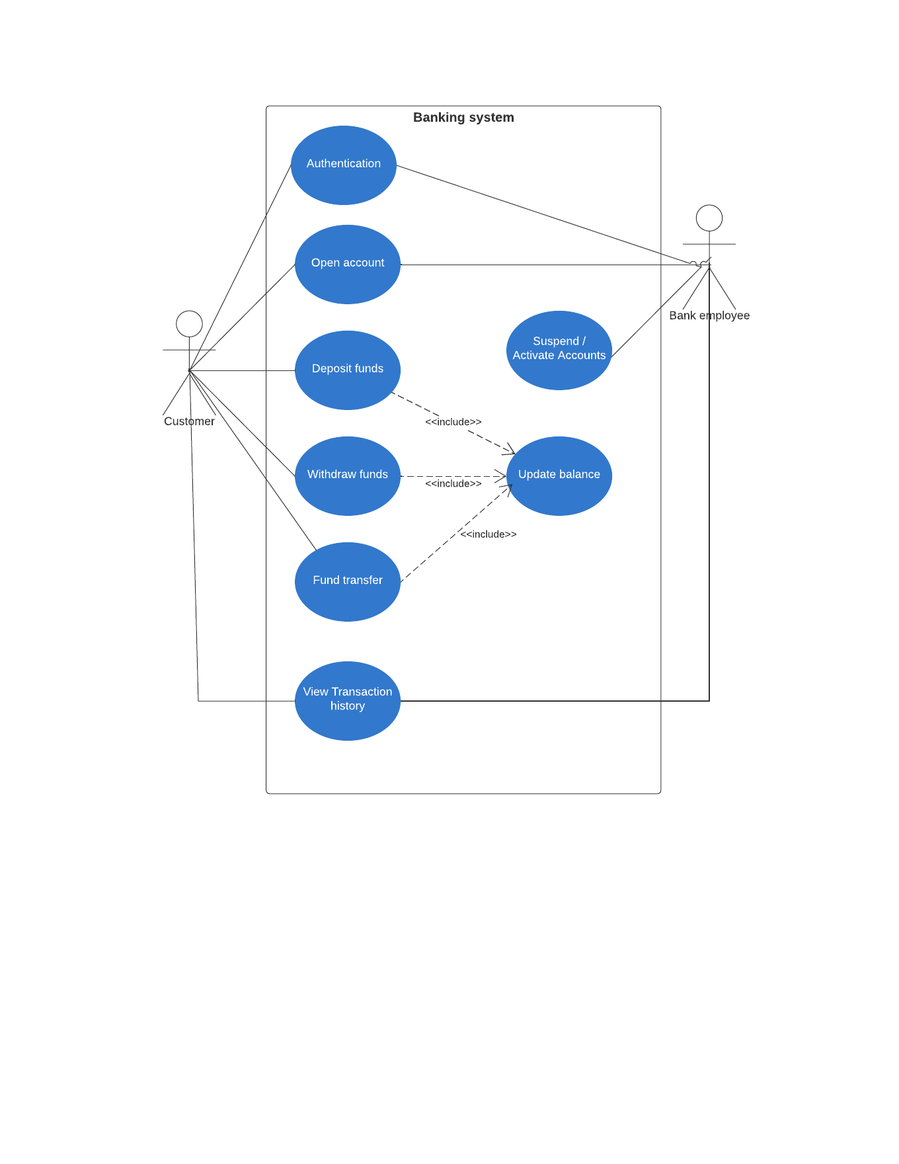
Uml Diagram

Slide 7
Major features implementation

Slide 8
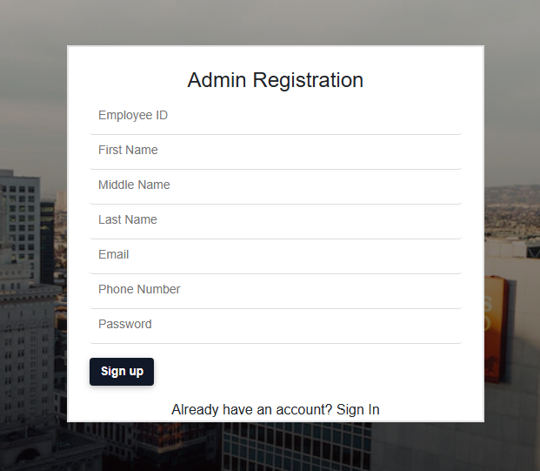
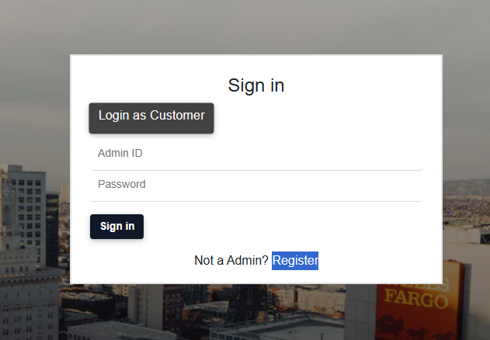
Authentication

Slide 9
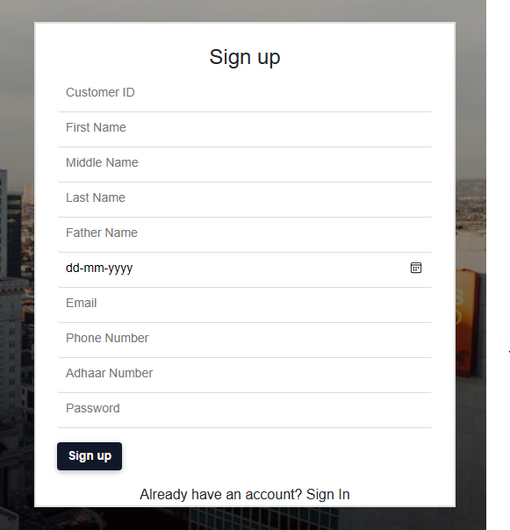
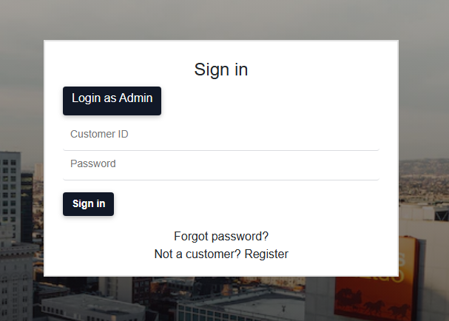

Slide 10
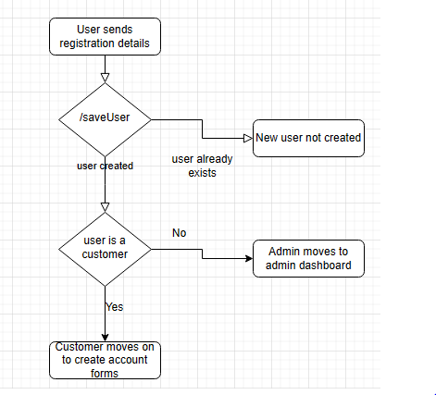
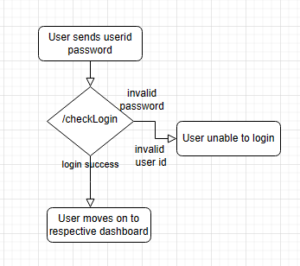

Slide 11
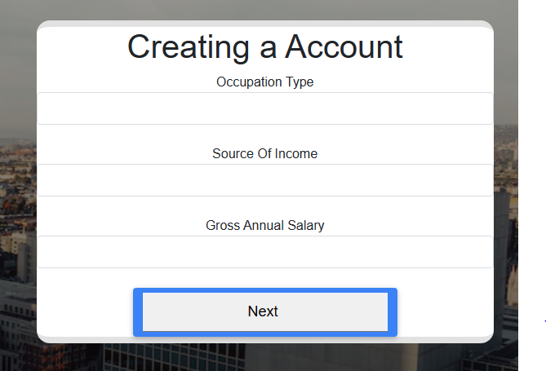
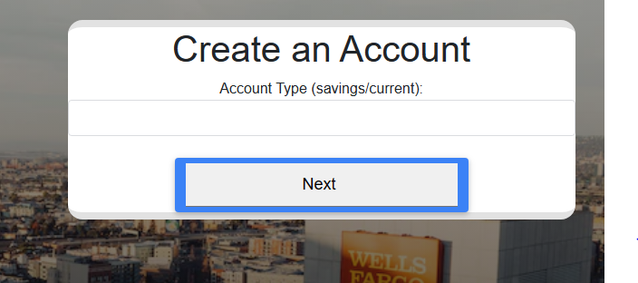
Create Account

Slide 12
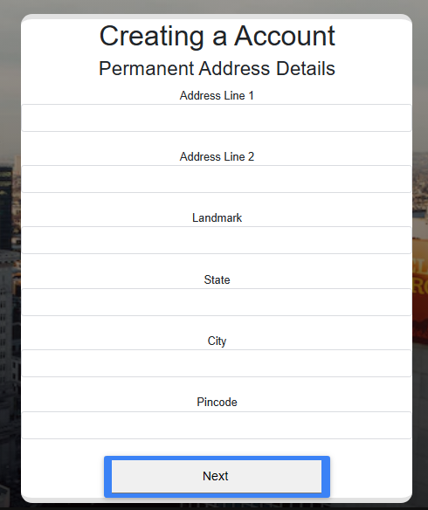
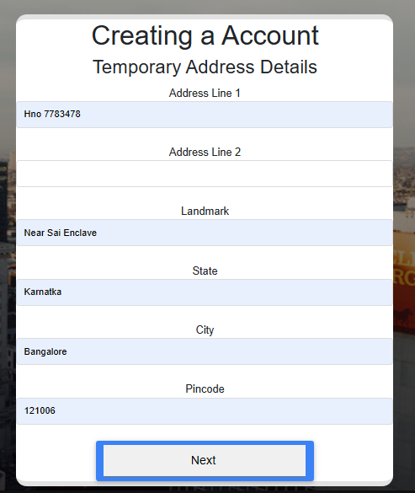

Slide 13
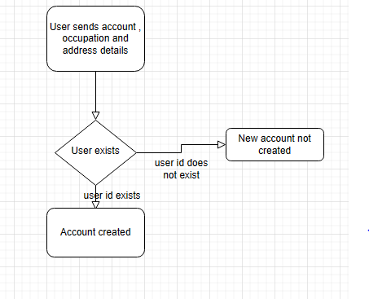

Slide 14
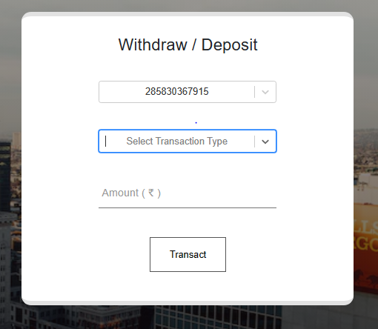
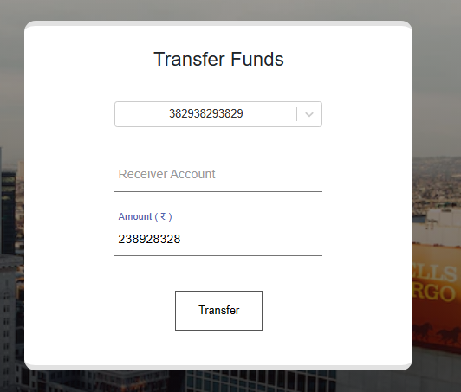
Transactions

Slide 15
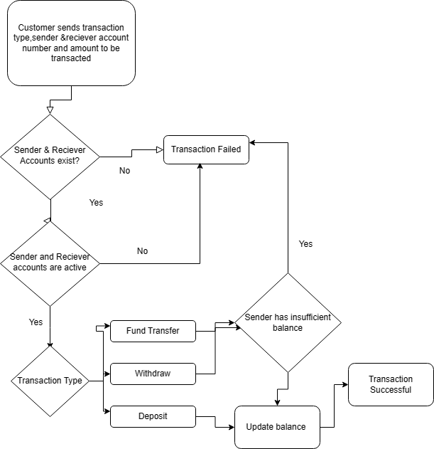

Slide 16
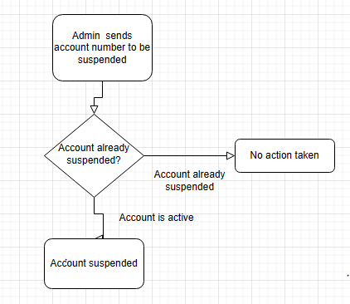
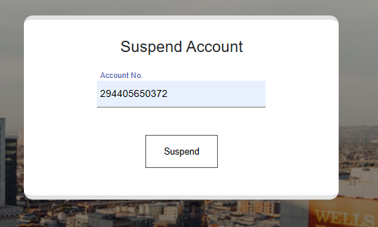
Suspend Account

Slide 17
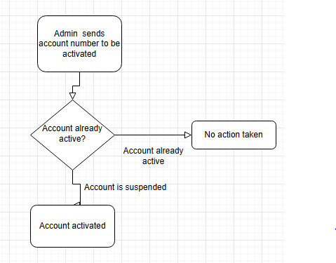
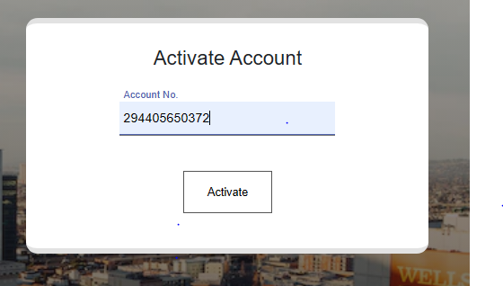
Activate Account

Slide 18
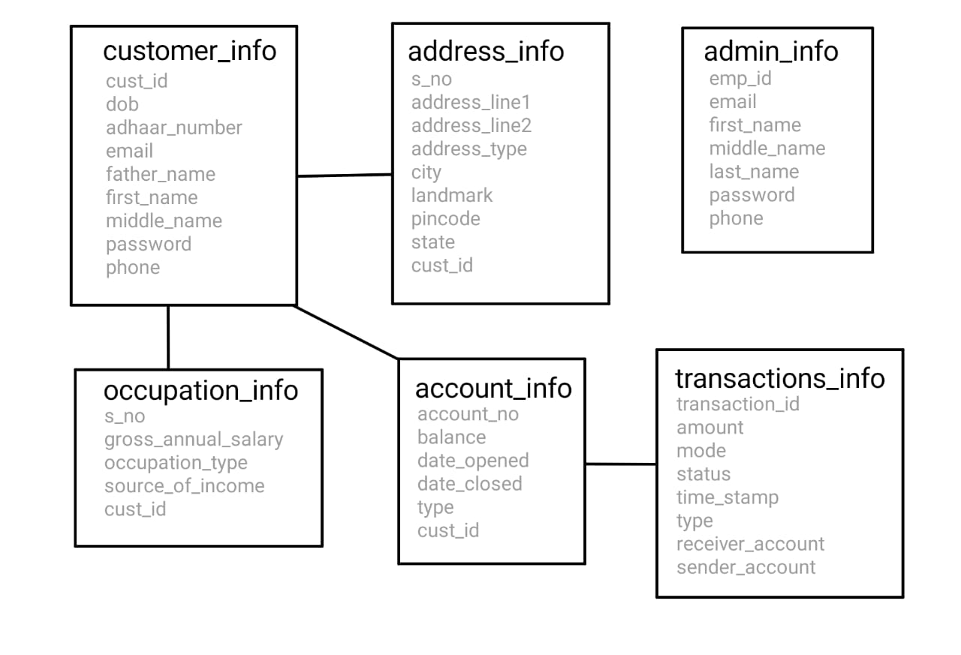
ER Diagram

